Slide 1
Medical Files
Access by insurers via court demand

Slide 2
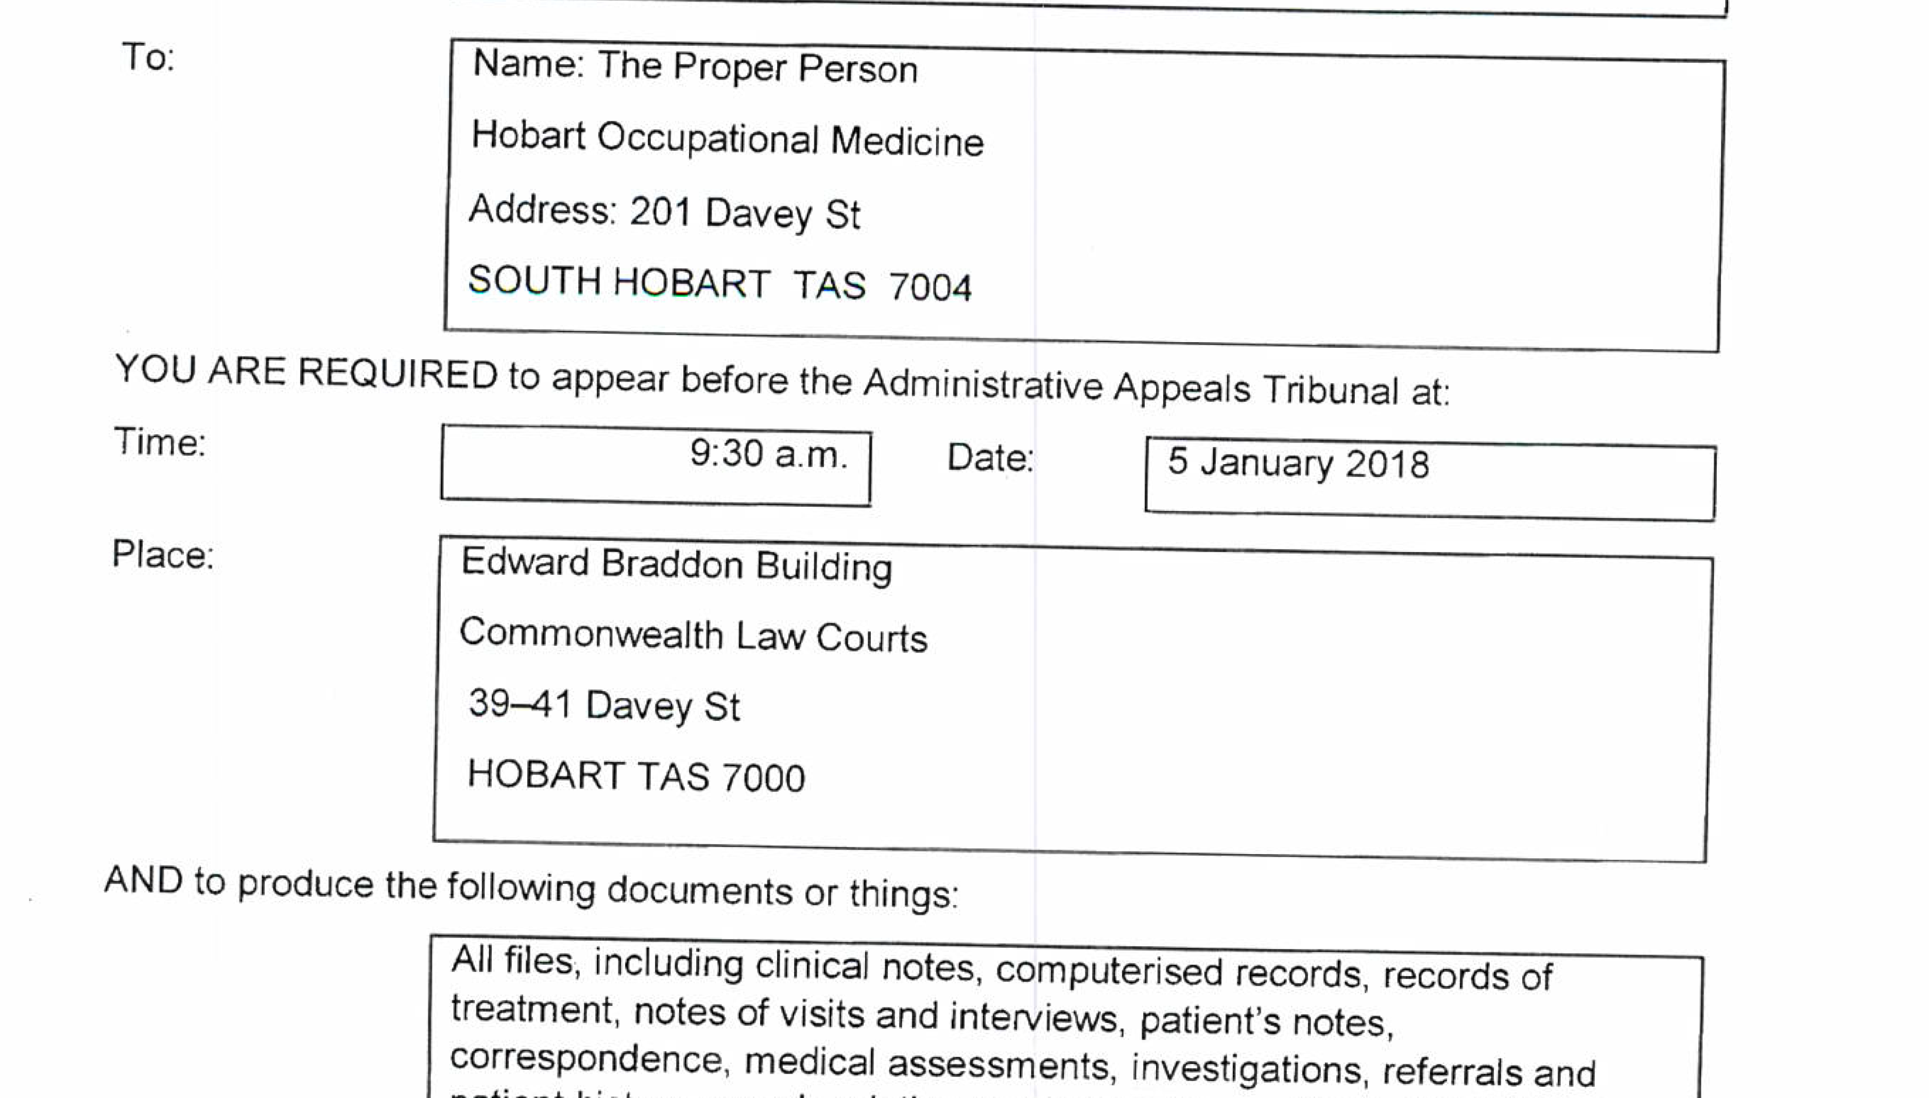
The issue

Slide 3
Trends 1
Increasing requests for medical file access by “financial” organisations to establish entitlements:
  Workers compensation insurance
  Income protection & related insurance
  Life Insurance
  Social security entitlements
Most requests are direct from the insurer or their agent with a patient’s “authority”

Slide 4
Trends 2
Increasing complexity due to chronic disease
Increasingly rigid compartmentalization of treatment funding:
  Medicare
  Private Health Insurance
  Workers Compensation
  DVA

Slide 5
Where?
Commonwealth jurisdictions in AAT
  Comcare
  DVA
Family Court
Workers Compensation & Rehabilitation Tribunal Tasmania
Criminal jurisdictions

Slide 6
Why?
Legal trends
Increased competition
Focus on cost containment

Slide 7
Accepted grounds for objection
“Circumstances where a member may decide that it might not be appropriate to issue the summons include where the information sought in the summons is not relevant to the issues in the dispute or where the summons is too broad or incomprehensible.”
  i.e. relevance of documents, scope of summons or lack of clarity
Protection of privacy is discretionary
BUT
Nothing about “harm”

Slide 8
Issues
Legal intrusion into medicine
“Refusal to Treat”
Misinterpretation of notes
Devaluing the confidential doctor : patient relationship
  Patient non-disclosure
  Doctor – disincentive to record
  Patient expectations
Risk of harm – at system and individual level
Abuse of a process necessary for criminal & national security matters
Lack of remuneration for doctors – an incentive for insurers?

Slide 9
Outcomes of Objections
AAT cases x 4
  Consult notes not provided to insurer (2)
  Complete file provided to insurer (1)
  Summons withdrawn (1)
WRCT cases x1
  Complete file provided to insurer’s lawyers (but not insurer)

Slide 10
Remuneration for objection
Carver and Comcare (Compensation) [2019] AATA 1534 (28 June 2019)
  No reimbursement for doctors time to prepare,object or communicate
  Insurer directed to pay for doctor’s time to attend court in relation to objection, and
  Obtain legal advice
BUT
  Caution about objecting without a valid reason
  Unlikely legal costs be reimbursed in future

Slide 11
Opinion
Responding to a summons for a file is not an administrative task
Medical input needed to assess risk & consult with patient
Try communication with the party requesting the summons
The legal requirement to respond to a summons does not absolve the doctor of professional duty to their patient especially when there is a legal option to object
There is provision to identify sensitive material and provide under separate cover

Slide 12
The future?
Trend of legally enforced release of medical files likely to continue
Medical Profession need to ‘push back’
Opportunity with AAT review of their summoning procedures
  Ensure negative aspects understood by legal system
  Purpose of summons needs to be articulated
  Incorporate assessment of risk of harm into procedures, including medical input (not just patient)
  Special status to doctor’s consultation notes
  Provide adequate remuneration for doctors to have input

